Slide 1

CODECONNECT - A SOCIAL MEDIA PLATFORM FOR CODERS
Team
SOHAM MANJREKAR
SHAIKH MUDASSER ALI
SAYED MOHAMMAD BAQUIR
SIDDIQUI ADAAB HUSAIN

Slide 2
04
KEY FEATURES
01
02
03
Developer Profiles and Portfolios
Coding Communities and Groups
Virtual Tech Events and Webinars
05
06
AI-Enhanced Collaboration
Sentiment Analysis
Code Challenges and Hackathons
07
08
09
Code Collaboration and Projects Showcase
AI-Powered Job Recommendations
Developer Blogging Platform
10
11
12
Personalized News Feed:
Developer Recognition and Awards
AI-Powered Mentorship Matching

Slide 3
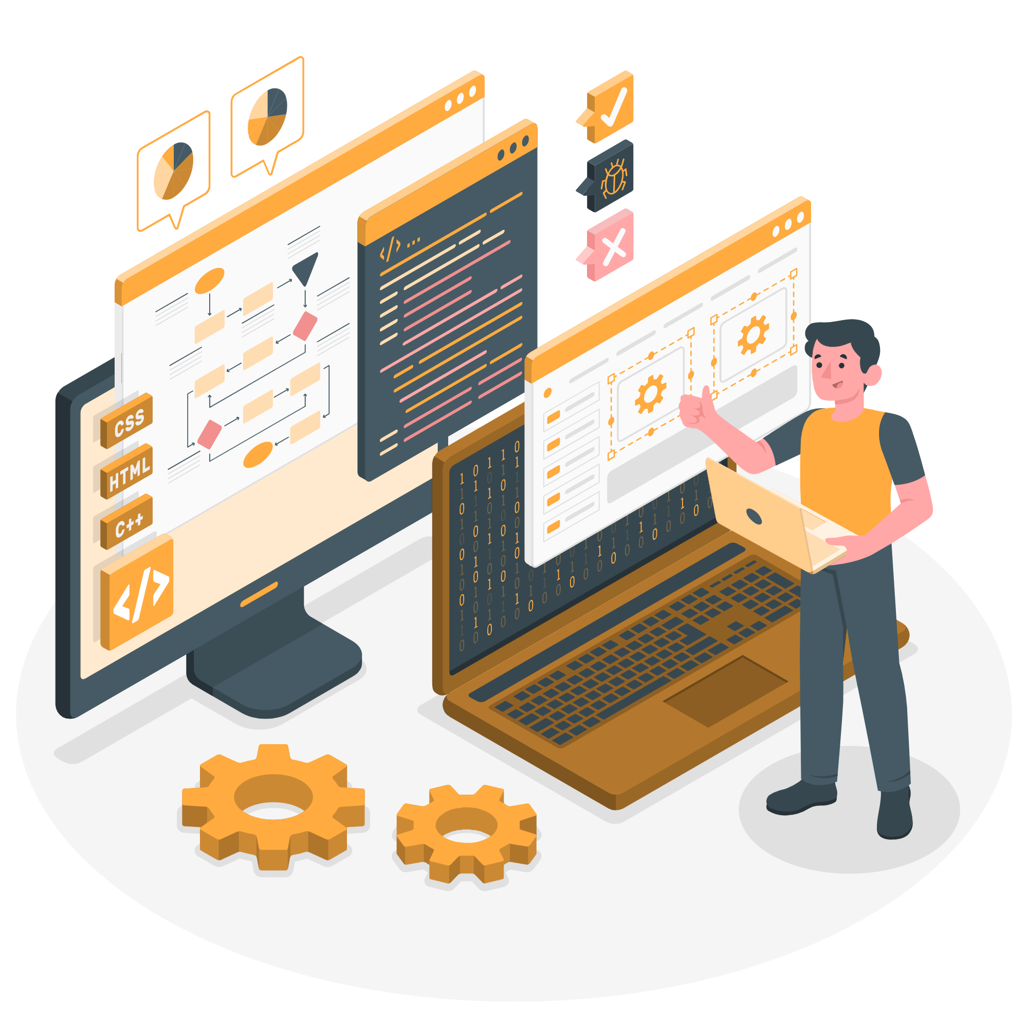
INTRODUCTION
Briefly introduce the project as a social media platform designed for coders and developers.
Mention the inspiration from LinkedIn and the unique focus on coding expertise and technical achievements.
In a world driven by technology, the coding community needs a space that caters to its unique requirements of networking, learning, and collaboration.

Slide 4

PROBLEM STATEMENT
The coding community faces challenges in finding relevant coding resources, connecting with like-minded individuals, and showcasing their skills.
Traditional social media platforms lack the tailored features required by coders to foster meaningful interactions and learning opportunities.
"CodeConnect" was born to address these challenges and create a platform that resonates with coders' needs.

Slide 5

TEAM MEMBERS
SHAIKH MUDASSER ALI
SOHAM MANJREKAR
SAYED MOHAMMAD BAQUIR
SIDDIQUI ADAAB HUSAIN

Slide 6

FEATURES OVERVIEW
Personalized User Profiles: Allow coders to showcase their skills, projects, and achievements in a dedicated space.
AI-Powered Recommendations: Utilize advanced AI algorithms to suggest relevant connections, coding communities, and learning resources.
Sentiment Analysis: Implement Natural Language Processing (NLP) to maintain a positive and collaborative environment.
Personalized Learning Paths: Leverage AI to tailor learning paths based on users' skills and learning objectives.

Slide 7
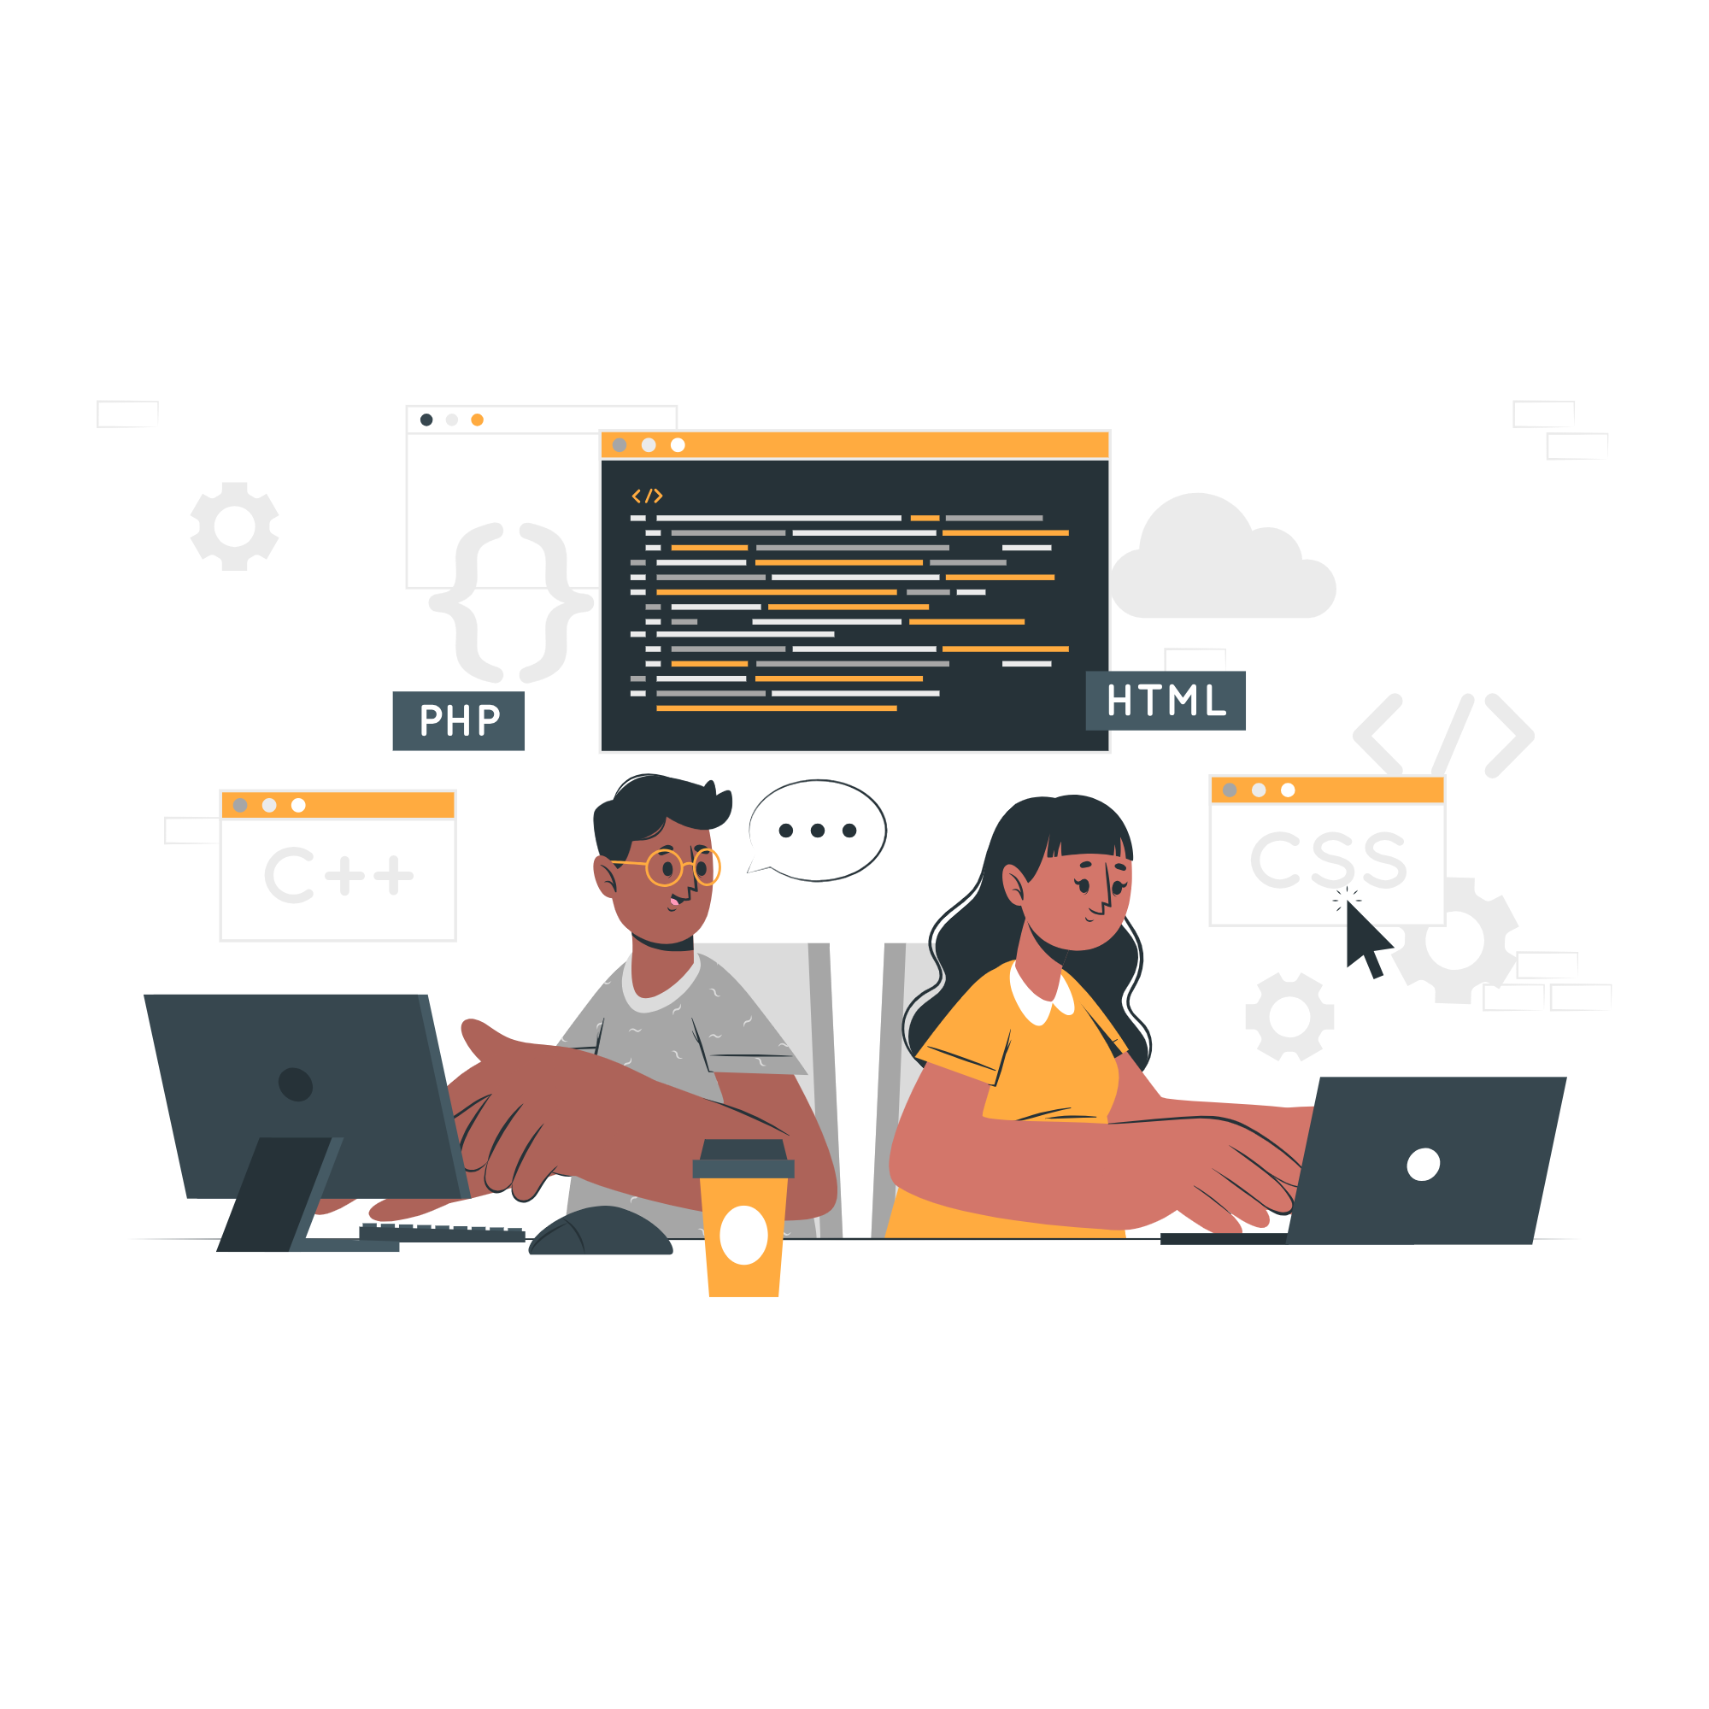
CONNECTING WITH OTHERS
"CodeConnect" facilitates connections with peers, mentors, and potential collaborators.
Endorsement feature allows users to validate each other's skills and achievements.
Building a strong network empowers coders and fosters collaborative growth.

Slide 8

CODING COMMUNITIES
Coding communities provide dedicated spaces for coders to interact based on their coding interests.
Users can join communities focused on specific programming languages, frameworks, or projects.
Communities encourage knowledge sharing, discussions, and collaborations.

Slide 9

Events and Challenges
"CodeConnect" hosts coding challenges, hackathons, and virtual tech events.
Users can participate, collaborate, and showcase their skills to the community.
AI-driven event suggestions ensure users engage with events that align with their interests and skills.

Slide 10

AI-POWERED RECOMMENDATIONS
AI analyzes user behaviors and preferences to provide personalized recommendations.
Recommendations include connections, coding communities, and learning resources.
AI enhances user engagement and expands learning opportunities.

Slide 11

SENTIMENT ANALYSIS
"CodeConnect" implements sentiment analysis using NLP techniques to foster positive interactions.
Sentiment analysis monitors text content for positive, negative, or neutral sentiment.
A positive environment encourages constructive conversations among users.

Slide 12

PERSONALIZED LEARNING PATHS
AI-driven personalized learning paths cater to each user's skill level and goals.
Based on user behavior and interests, the platform recommends tutorials, courses, and coding challenges.
Learning paths enhance skills development and empower coders to achieve their coding aspirations.

Slide 13

Conclusion
"CodeConnect" is a platform that:
Creates a dedicated coding community.
Enables meaningful connections among coders.
Enhances learning through AI and ML.
We are excited about the potential impact "CodeConnect" can have on the global coding community

Slide 14

THANKS!
Do you have any questions?
+91 7045208474
sohammanjrekar@eng.rizvi.edu.in

